Slide 1

Testing of Online Examination Portal
192011292
G.S.Geetha

Slide 2

Abstract
Online Examination Portal includes acute details about objectives of the structure, portal scope restraint, portal action model, primary structure requirements, schedule of the examination , and eventually surveying mechanisms for the entire portal structure.
Online Examination Conducting Portal is very beneficial for Educational Institute's to formulate an entire exam, saving time to check the papers and concoct mark sheets.
Finally, the required testing process is carried out to the online examination portal to check all the positive and negative scenarios of the given application.

Slide 3
Objective
The main objective of this project is to test the features of online examination portal by implementing various positive and negative testcases and scenarios.

Slide 4

Proposed SYSTEM:-
To develop the testing environment , appium software is installed in the windows. And IntelliJ is an another software, a JDK , which provides us an environment to run java programs.
For visualization , android studio is installed.
The functionalities that are involved in this online examination system involves below :
->student data management
->login details

Slide 5
->exam schedule
->request for hall ticket.
->generate hall ticket
->seating plan for students
->add new tests or exam updates.
->calculate marks
->exam results
->evaluate grade

Slide 6
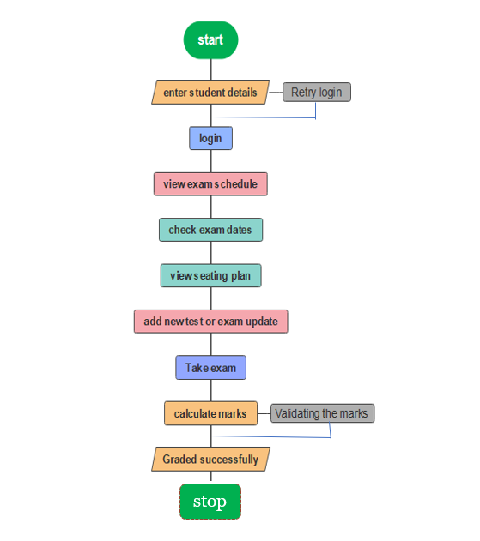
Flow Chart

Slide 7
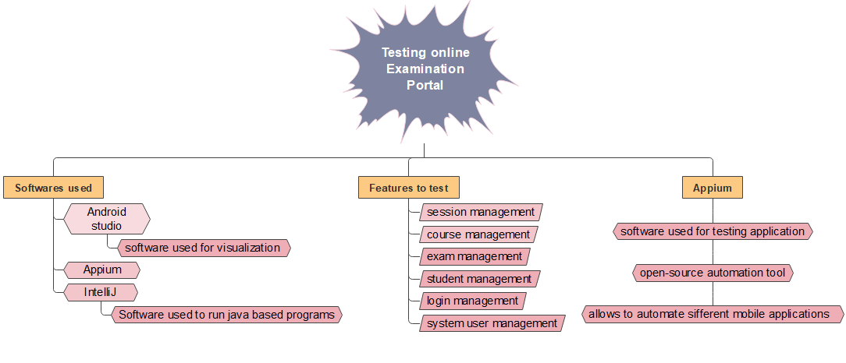
Concept mapping

Slide 8

Test scenarios
TEST CASES | POSITIVE / NEGATIVE
1. Enter valid email id or mobile no. | Positive
2. Enter valid course code. | Positive
3. Enter invalid course code. | Negative
4. Click on submit button and find out portal home page. | Positive
5. Enter invalid registration no or mobile no. | Negative
6. Improper courses and test’s update. | Negative
7. Click on schedule and find out the exam schedule page. | Positive
8. Irrelevant seating planning respective to the selected course. | Negative
9. Verify that examiner can set details for each question- Question, options , marks | Positive
10. Verify the results of the student after completion of exam | Positive

Slide 9



APP TOOLS
APPIUM
INTELLIJ
ANDROID STUDIO

Slide 10
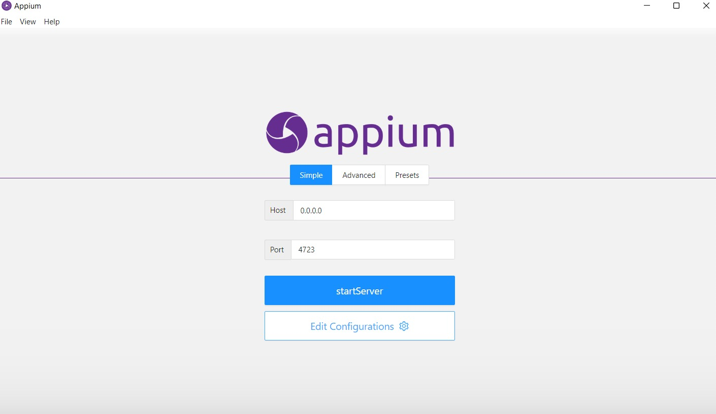
INSTALLATION OF APPIUM SERVER

Slide 11
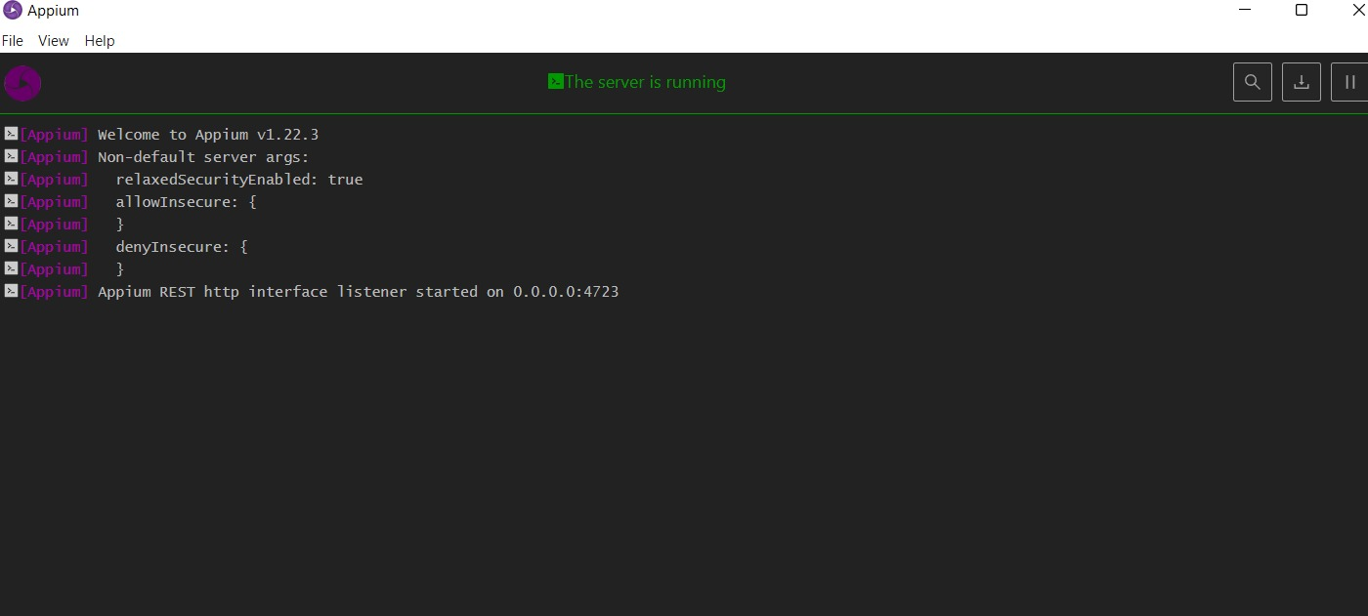
APPIUM SERVER

Slide 12
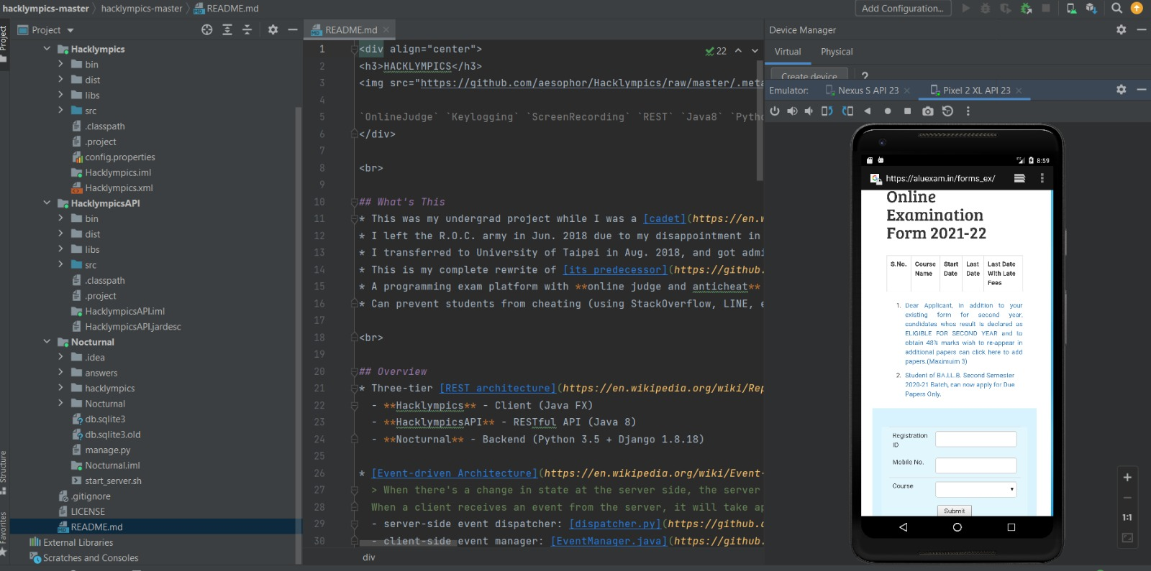
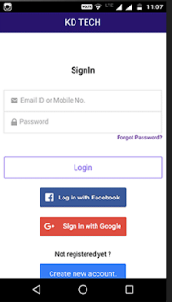
Android Studio

Slide 13
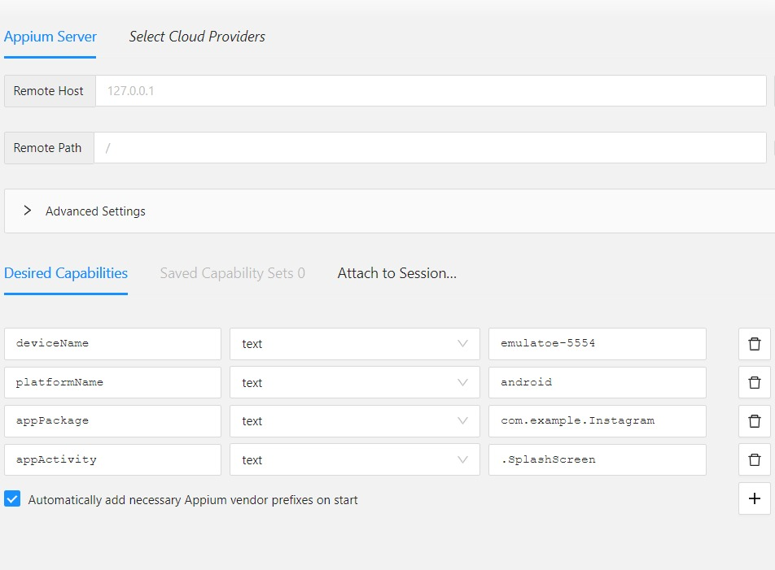
IMPLEMENTATION OF TESTING

Slide 14
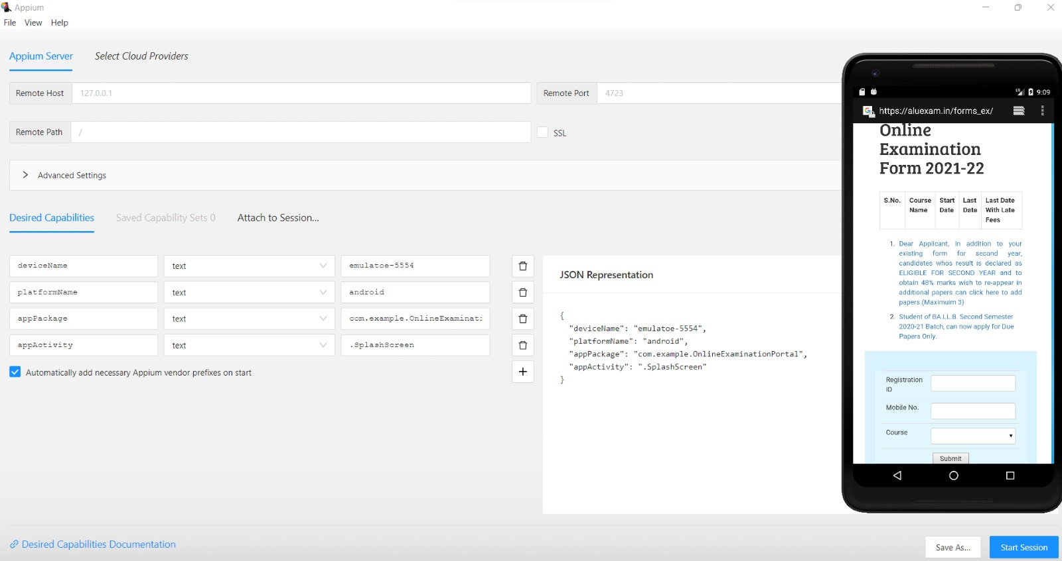
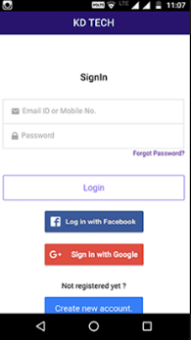
TESTING OUTPUTS

Slide 15
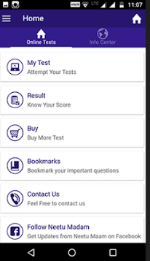
TESTING OUTPUTS

Slide 16
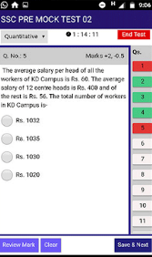
TESTING OUTPUTS

Slide 17

conCLUSION
Thus the required software’s needed for testing are installed successfully.
The aim to test the features of the online examination portal is tested with all the test scenarios successfully.

Slide 18

THANK YOU

